Slide 1
DATA SCIENCE PROJECT PROPOSAL
Predicting NVIDIA Stock Prices Using Machine Learning Models
SHAHID ALI KHOWAJA
23034289
1

Slide 2
Agenda
Project Overview
Project Objective
Research Question
Dataset Description
Evaluation Metrics
Methodology
Project Timeline
Data Management and Security
Conclusion
2

Slide 3
Project Overview
Stock price prediction is critical for investors to make informed decisions.
NVIDIA is a highly volatile stock influenced by AI advancements and semiconductor demand.
This project compares LSTM and ARIMA models to determine predictive accuracy, stability, and adaptability.

Slide 4
Project Objectives
Develop Predictive Models – Implement LSTM (deep learning) and ARIMA (time-series) models.
Compare Forecasting Horizons – Evaluate short-term (daily/weekly) vs. long-term (monthly/yearly).
Assess Accuracy – Use MAE, RMSE, and R² scores to compare performance.
Analyse Market Volatility Impact – Assess how well the models adapt to sudden fluctuations.
Provide Investor Insights – Identify which model offers more reliable forecasts for market conditions.

Slide 5

Research Question
Short-term vs. Long-term: Does LSTM outperform ARIMA for short-term predictions?
Model Accuracy: Which model has lower error rates (MAE, RMSE, R²)?
Market Volatility Handling: How do LSTM and ARIMA respond to sudden stock fluctuations?
Reliability in High Volatility: Are predictions useful during unstable market conditions?

Slide 6
Dataset Description
Dataset : NVIDIA Data from Kaggle
Dataset Details: 1,699 entries, 7 key stock features
Features:
Date, Open, High, Low, Close, Adjusted Close, Volume. Size: 186KB, containing 1 CSV files
Data Cleaning:
Handling missing values..
Converting non-numeric data to numeric format.
Normalization and feature engineering for better predictions.

Slide 7
EVALUATION METRICS
Mean Absolute Error (MAE): measures the average absolute difference between actual and predicted prices.
Root Mean Squared Error (RMSE): evaluates error magnitude, penalizing large errors more.
R² Score: determines how well the model explains variance in stock prices.
Market Volatility Adaptability: assesses model performance during economic events.
7

Slide 8
Methodology
NVIDIA STOCK PRICE PREDICTION:
ARIMA (AutoRegressive Integrated Moving Average) for statistical time-series forecasting.
LSTM (Long Short-Term Memory) is employed for forecasting within the realm of deep learning.
Steps:
Data Cleaning and Preprocessing.
Exploratory Data Analysis (EDA).
Model Selection and Implementation.
Insights Generation.
8

Slide 9
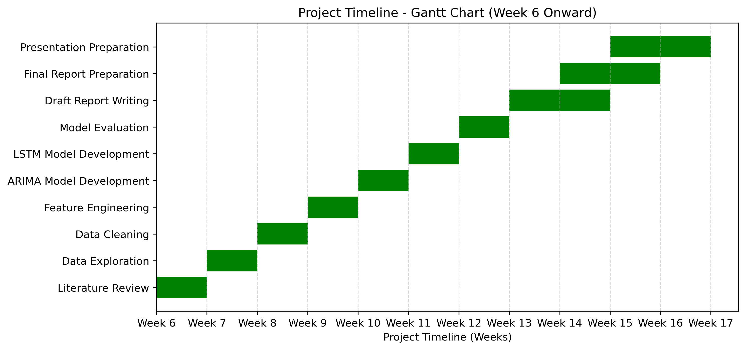
Project Timeline

Slide 10
Data Management & Security
Data Storage & Version Control:
GitHub Repository.
Regular weekly commits to track progress..
Transparent file naming conventions for easy comprehension.
Security Measures:
Regular data backups..
Storage on both GitHub and Google Drive.
Ethical Considerations:
Using an open data source (NVIDIA Dataset).
Following university ethical guidelines.

Slide 11

Conclusion
This project successfully investigated and applied machine learning (LSTM) and statistical (ARIMA) models to forecast NVIDIA stock prices using historical data. We discussed how well the models can predict stock price trends and inform investment decisions through data gathering and pre-processing, model training, and model evaluation.
Next Steps
Complete the development and assessment of the model.
Finalize the outcomes and formulate the recommendations.

Slide 12
Thank you

